Slide 1
Constrained Mean Shift Using Distant Yet Related Neighbors for Representation Learning
Navaneet K L^{1,*}, Soroush Abbasi Koohpayegani^{1,*}, Ajinkya Tejankar^{1,*}, Kossar Pourahmadi¹, Akshayvarun Subramanya², Hamed Pirsiavash¹
¹University of California, Davis ²University of Maryland, Baltimore County
^{* Equal contribution}
https://github.com/UCDvision/CMSF

Slide 2
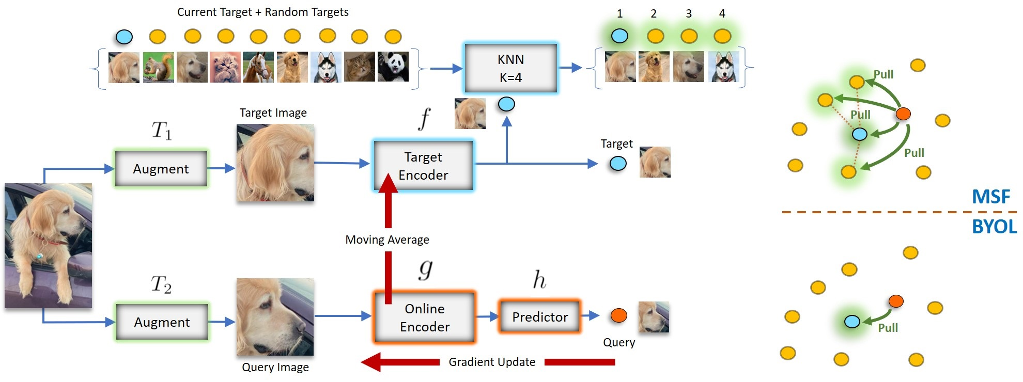
Mean Shift for Representation Learning ^{[1]}
Mean Shift (MSF)^{[1]} and NNCLR^{[2]} force a target image to be close to the mean of its k-nearest neighbor embeddings.
Overview of Mean Shift (MSF)^{[1]} approach. Image obtained from [1].
[1] Koohpayegani et al. Mean shift for self-supervised learning. ICCV, 2021
[2] Dwibedi et al. With a little help from my friends: Nearest-neighbor contrastive learning of visual representations. ICCV, 2021

Slide 3
Drawback of MSF
By design, chosen neighbors are close to target.
→ not a strong signal.
Find samples such that
They are semantically related to the target image.
Far from the target in the feature space.

Slide 4
Solution: Constrained Mean Shift (CMSF)
Mean of nearest neighbors, like MSF.
Target Image
Target Encoder
Augment
Target
Moving Average
Predictor
Pull
Online Encoder
Augment
Query
Query Image
Gradient Update

Slide 5
Solution: Constrained Mean Shift (CMSF)
Mean of nearest neighbors, like MSF.
Use a constrained set for NN search → constrained NNs must be ranked higher in the unconstrained set.
Target Image
Target Encoder
Constrain
Pull
Augment
Target
Moving Average
Predictor
Constrained Target
Online Encoder
Random Target
Augment
Query
Query Image
Gradient Update

Slide 6
Solution: Constrained Mean Shift (CMSF)
General framework for positive sample selection.
Applicable to self-, semi- and fully supervised settings.

Slide 7
Solution: Constrained Mean Shift (CMSF)
Constrain the nearest neighbor search using extra knowledge.
Additional source of knowledge can be ground-truth / pseudo-labels, additional input domains, augmented images etc.
Knowledge source determines the degree of supervision available.
Source of Knowledge
Semi-Supervised
Supervised
Self-Supervised
Pseudo-Labels
Labels
$3^{rd}$ augmentation
Constrain
Pull
Constrained Target
Random Target

Slide 8
Self-supervised Constrained Mean Shift
Knowledge source must be self-supervised.

Slide 9
Self-supervised Constrained Mean Shift
Knowledge source must be self-supervised.
Solution: Use an additional augmentation of target

Slide 10
Self-supervised Constrained Mean Shift
Knowledge source must be self-supervised.
Solution: Use an additional augmentation of target??
Need diverse samples, not just augmentations of same image.

Slide 11
Self-supervised Constrained Mean Shift
Knowledge source must be self-supervised.
Solution: Use an additional augmentation of target??
Need diverse samples, not just augmentations of same image.
Augmentation used only for NN search, optimization still with target image!

Slide 12
Self-supervised Constrained Mean Shift
Knowledge source must be self-supervised.
Solution: Use an additional augmentation of target??
Need diverse samples, not just augmentations of same image.
Augmentation used only for NN search, optimization still with target image!
Semantic relation of constrained NNs to target will be similar to that of unconstrained NNs.

Slide 13
Self-supervised Constrained Mean Shift
Knowledge source must be self-supervised.
Solution: Use an additional augmentation of target??
Need diverse samples, not just augmentations of same image.
Augmentation used only for NN search, optimization still with target image!
Semantic relation of constrained NNs to target will be similar to that of unconstrained NNs.
NNs of augmentation (constrained NNs) are not necessarily NNs of target (unconstrained NNs).

Slide 14
Self-supervised Constrained Mean Shift
Efficient implementation with two memory banks – one each for previous and current epoch features.
Previous features (M’) → NN search, Current (M) → Optimization
Memory Bank
Previous Epoch Augmentation
Target Encoder
Memory Bank
Current Epoch
Augmentation

Slide 15
Self-supervised Constrained Mean Shift
Find top-k’ NNs of in memory bank M’
Memory Bank
Previous Epoch Augmentation
Target Encoder
Memory Bank
Current Epoch
Augmentation

Slide 16
Self-supervised Constrained Mean Shift
Find top-k’ NNs of in memory bank M’.
Find corresponding elements in memory bank M.
Memory Bank
Previous Epoch Augmentation
Target Encoder
Memory Bank
Current Epoch
Augmentation

Slide 17
Self-supervised Constrained Mean Shift
Find top-k’ NNs of in memory bank M’.
Find corresponding elements in memory bank M.
Obtain the constrained set C.
Memory Bank
Previous Epoch Augmentation
Target Encoder
Memory Bank
Current Epoch
Augmentation
Constrained Set

Slide 18
Self-supervised Constrained Mean Shift
Find top-k’ NNs of in memory bank M’.
Find corresponding elements in memory bank M.
Obtain the constrained set C.
Find top-k NNs in C.
2
4
Neighbor Selection
Memory Bank
3
1
3
Loss Calculation
Memory Bank
Constrained Set
1
2
4

Slide 19
Supervised Constrained Mean Shift
Positive sample selection → trivial in presence of GT labels.
Objective function same as in SSL, no cross-entropy loss.

Slide 20
Supervised Constrained Mean Shift
Only top-k neighbors are used:

Slide 21
Supervised Constrained Mean Shift
Only top-k neighbors are used:
Helps preserve latent structure of categories.

Slide 22
Supervised Constrained Mean Shift
Only top-k neighbors are used:
Helps preserve latent structure of categories.
More robust to noise in labels.

Slide 23
Supervised Constrained Mean Shift
Only top-k neighbors are used:
Helps preserve latent structure of categories.
More robust to noise in labels.

Slide 24
Supervised Constrained Mean Shift
Only top-k neighbors are used:
Helps preserve latent structure of categories.
More robust to noise in labels
→ Applied to semi-supervised learning with noisy pseudo-labels.

Slide 25
Semi-supervised CMSF
Train a MLP classifier to obtain pseudo-labels.
Replace the ground-truth labels in supervised CMSF with pseudo-labels.

Slide 26
Experiments and Results
Experiments on all three supervision settings.
Training on ImageNet-1k dataset.
Linear evaluation on ImageNet-1k.
Transfer evaluation on ten classification tasks.

Slide 27
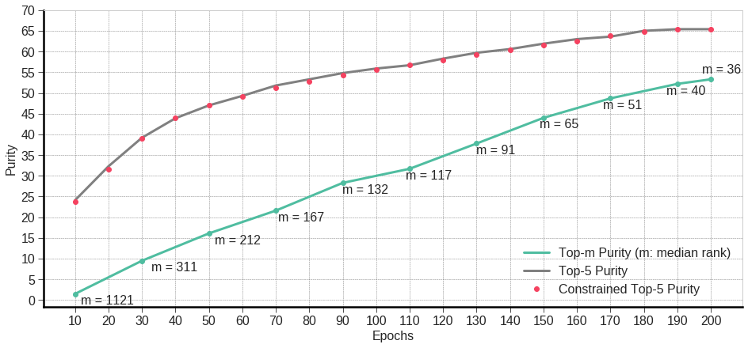
Observations on Constrained NNs
Chosen NNs are (1) related to target

Slide 28
Observations on Constrained NNs
Chosen NNs are (1) related to target (2) far away from target

Slide 29
Observations on Constrained NNs
Such samples cannot be trivially obtained by sampling more NNs in unconstrained set.

Slide 30
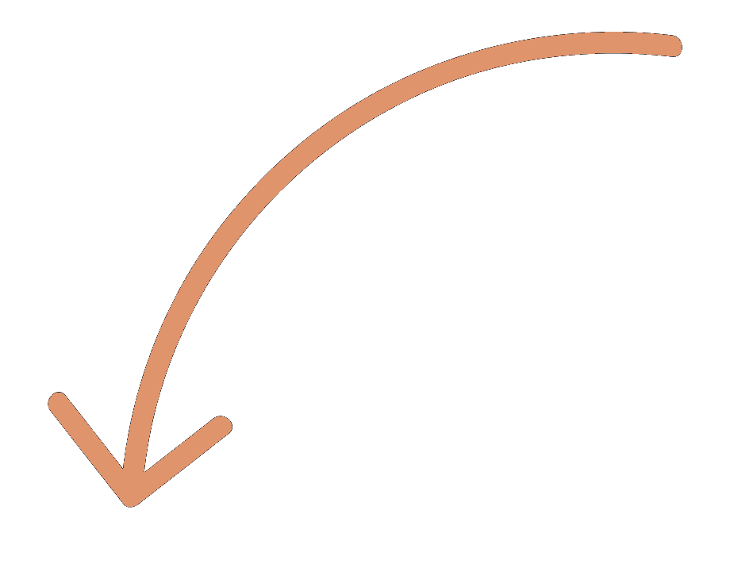
Observations on Constrained NNs
Diversity in constrained and unconstrained NNs.
Target image can look very different from constrained NNs.

Slide 31
Observations on Constrained NNs
Constrained and unconstrained NNs differ heavily during the initial stages of training and have higher overlap at the end.
Suggests that the use of constrained NNs is beneficial.

Slide 32
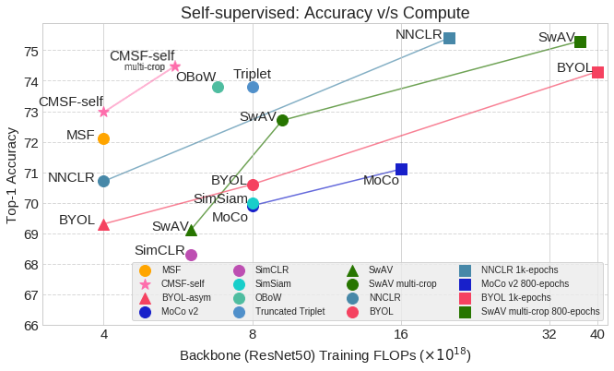
Self-supervised Results on ImageNet-1k
High efficiency and performance!

Slide 33
Self-supervised Results on ImageNet-1k
High efficiency and performance!

Slide 34
Self-supervised Results on ImageNet-1k

Slide 35
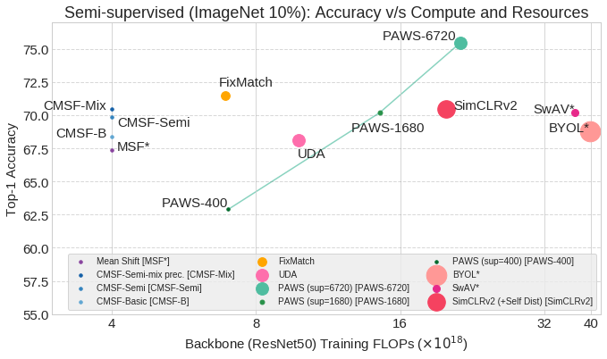
Semi-supervised Results on ImageNet-1k
Highly resource (GPUs) and compute efficient. Best performance for comparable compute.

Slide 36
Semi-supervised Results on ImageNet-1k
Highly resource (GPUs) and compute efficient. Best performance for comparable compute.

Slide 37
Thank You!
Code and pre-trained models are publicly available at https://github.com/UCDvision/CMSF

